Slide 1
Advanced SEO for Web Developers
Nathan Buggia
Lead Program Manager
Microsoft Webmaster Center
Notes:
SPEAKER NOTES
--------------------
Hey, I’m nate
Way too much content in this deck to cover
Goal is to:
Convince you of the value of adopting these best practices
Give you a sense of the biggest issues
Provide a reference you can download later and fix everything you need to.
Also, I big into real world examples, so if anyone has a website you want me to review, drop it on stage and at the end I’ll come take a look
Also, afterwards I’ll be at the Q&A place for as long as you need to answer any questions
In the building of any site, there are 10 people involved. Most orgs don't one person to do SEO, we think that will evolve. Kind of like security was 5 years ago.

Slide 2
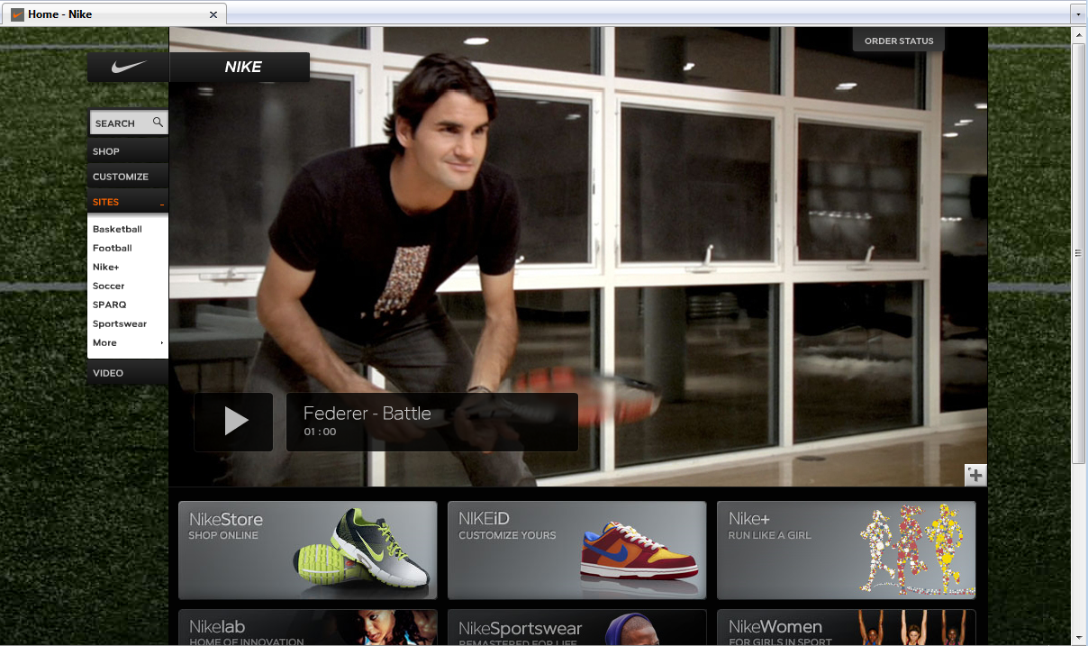
Nike.com
Notes:
Play the courage video linked from here: http://www.nike.com/nikeos/p/nike/en_US/video

Slide 3
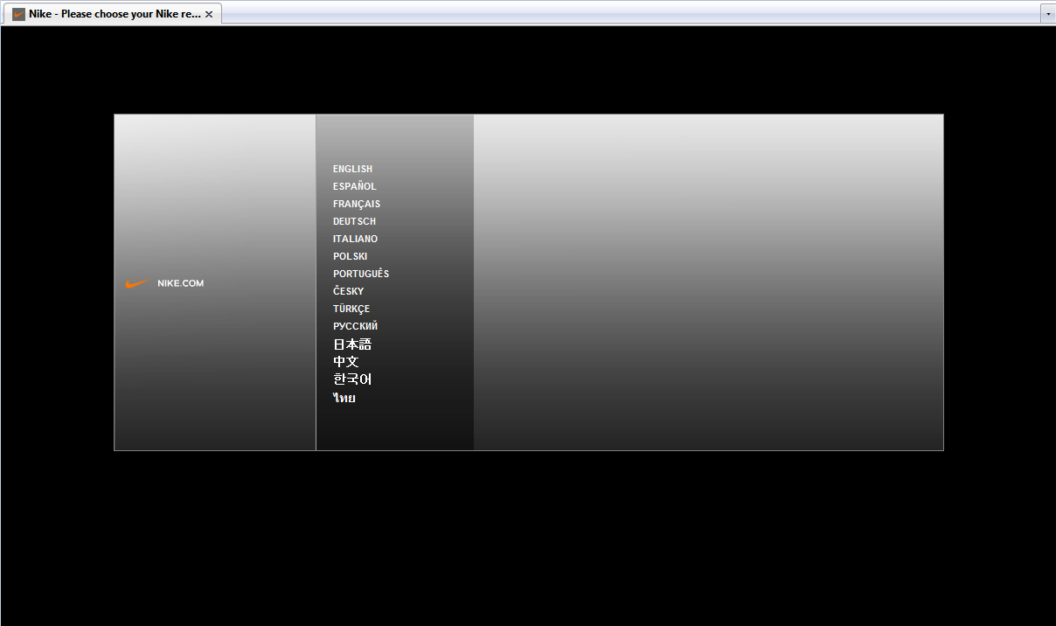
User Experience
Notes:
9.8 seconds (2 clicks) to load nike.com
7.6 secs for adidas.com
8 seconds for puma.com

Slide 4
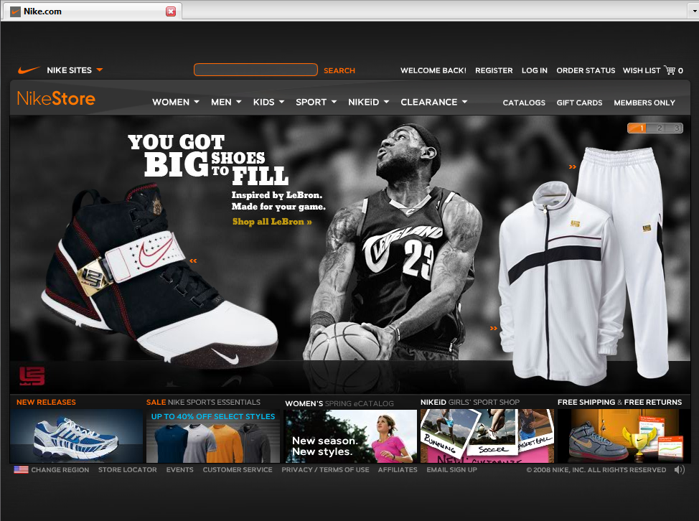
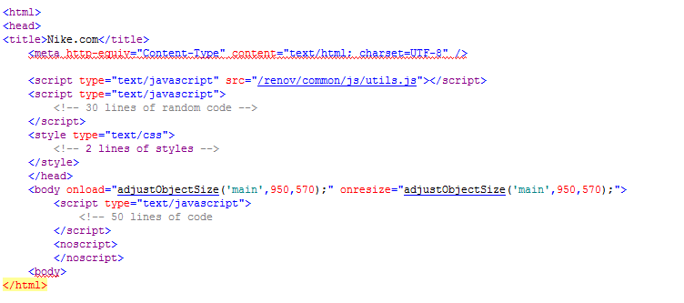
Search Engine Experience

Slide 5
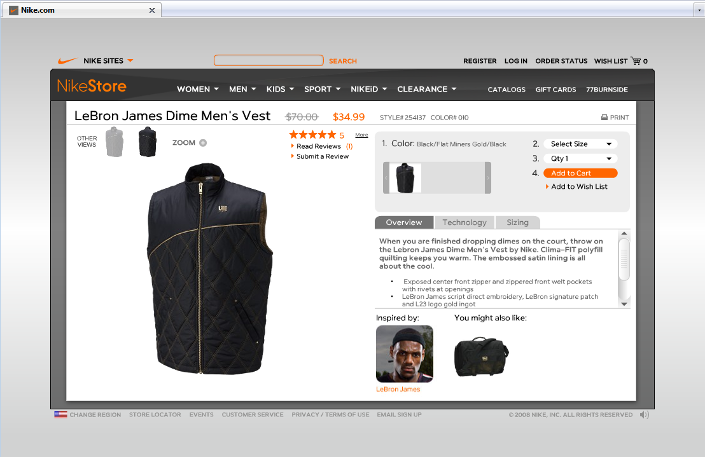
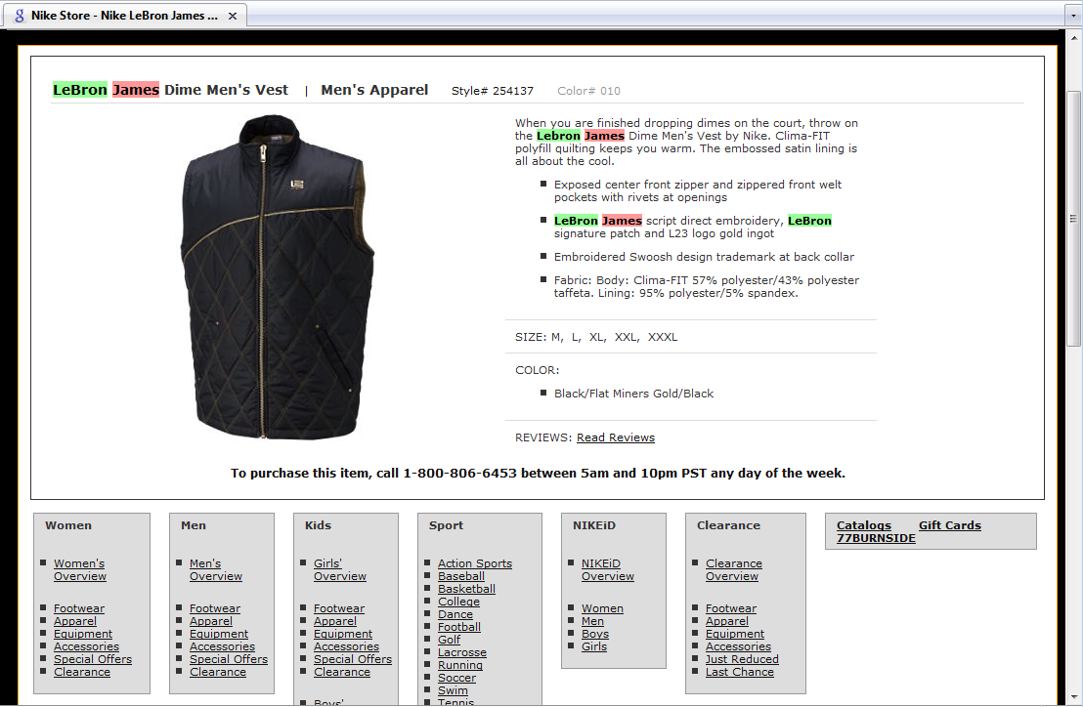
The Real Search Engine Experience

Slide 6
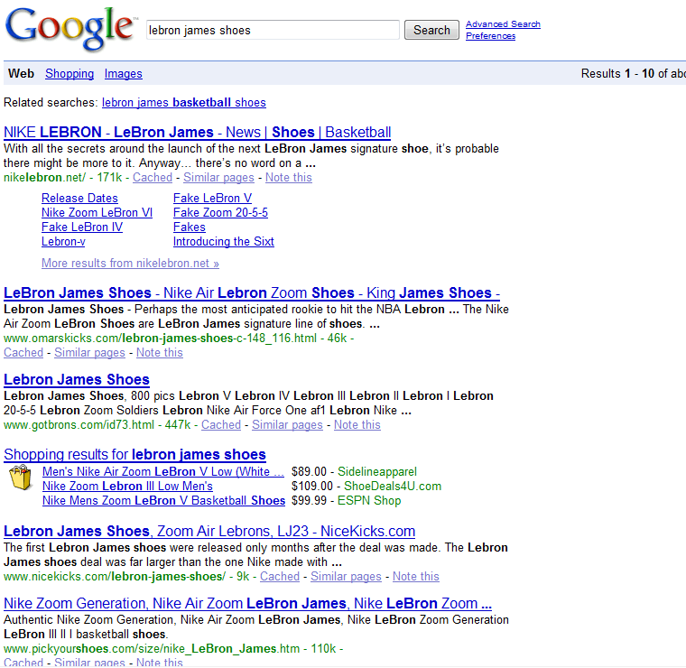
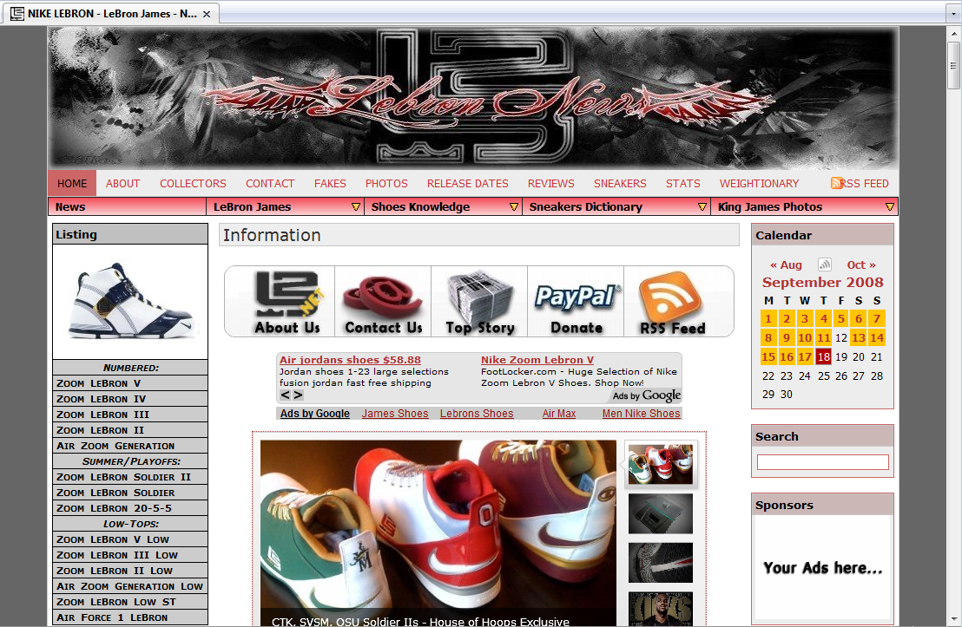
So What?
Notes:
Search is really important, it not only drives a lot of traffic to your site (over 30%) it should drives the right kind of traffic
First problem is that they are not showing up in search results for terms they should “Lebron James Shoes”. G=>500, Y=27, LS=>500

Slide 7
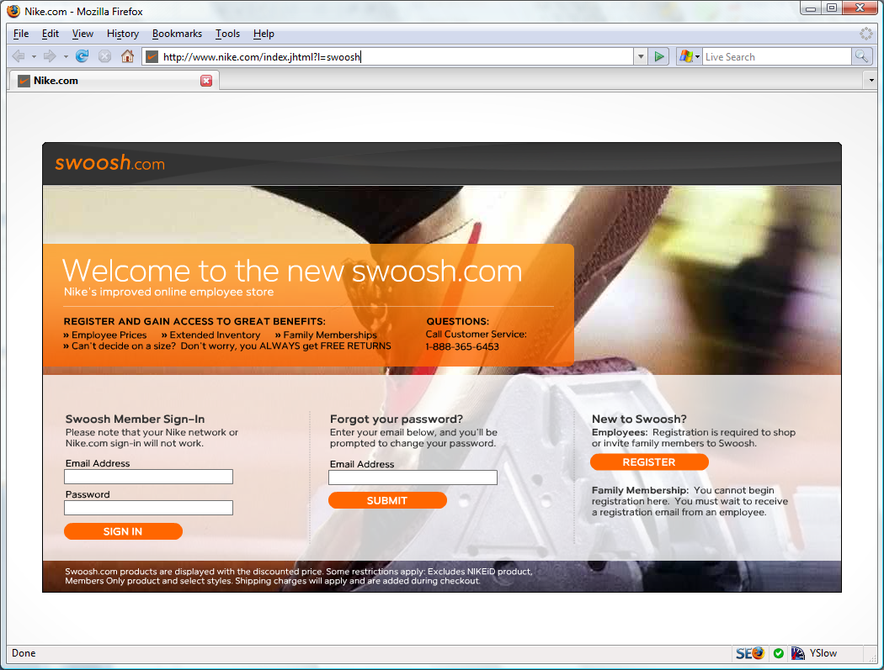
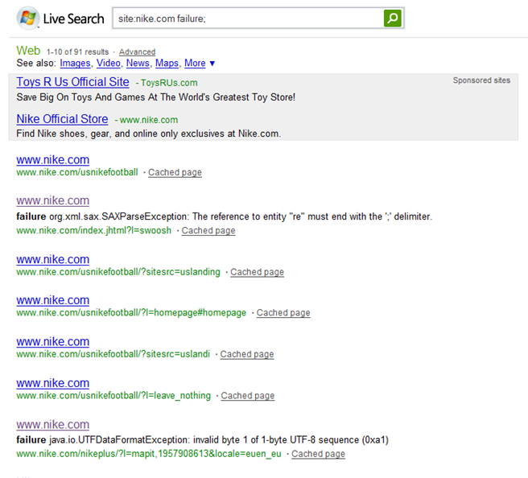
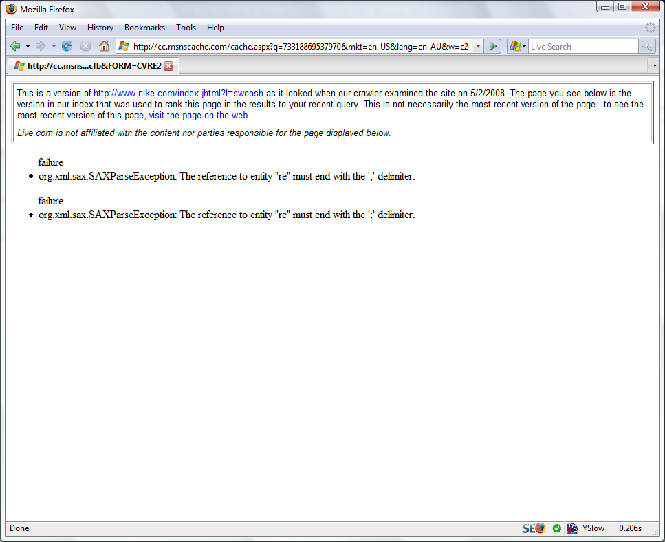
So What?
Notes:
Search is really important, it not only drives a lot of traffic to your site (over 30%) it should drives the right kind of traffic
First problem is that they are not showing up in search results for terms they should “Lebron James Shoes”. G=>500, Y=27, LS=>500

Slide 8
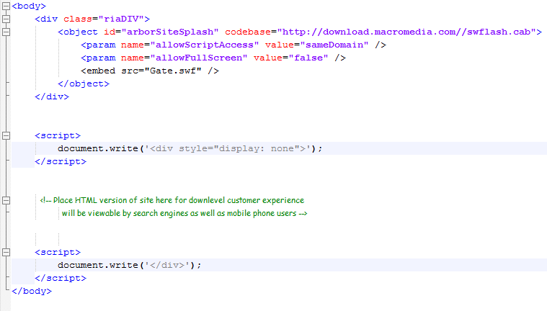
Alternate Implementation
Nikhil’s Design Pattern - http://www.nikhilk.net/AjaxSEO.aspx

Slide 9
Big Hard Problems
Affiliate/ URL Tracking
Session management
Rich internet applications
Duplicate content (canonicalization)
Geo-location
Understanding analytics
Redirection
Error management
…
Notes:
These are some of the things we’re going to talk about today.
I’m not going to teach you any coding, what I hope to do is help you understand the impact to search of various design decisions you make

Slide 10
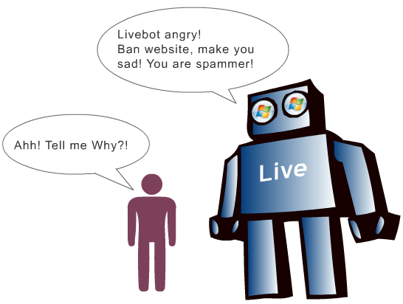
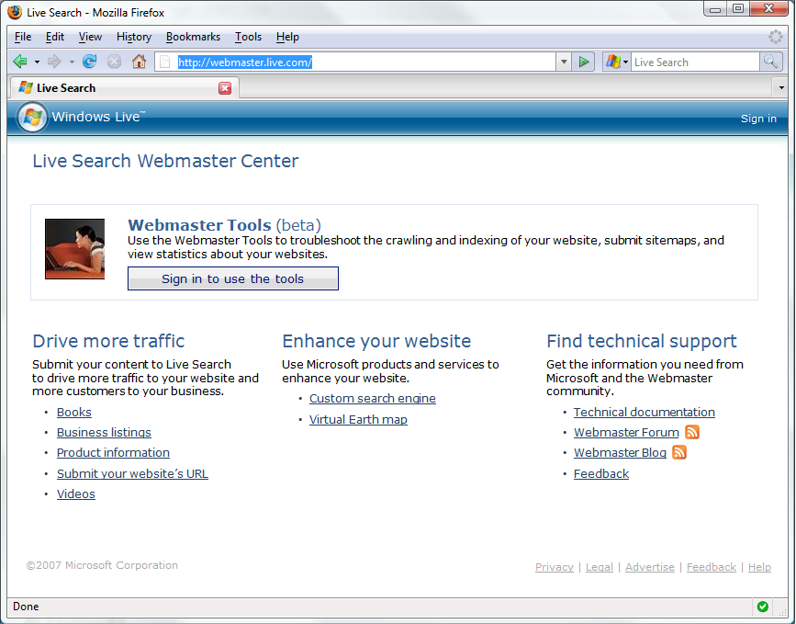
Hello, I’m Nathan Buggia
And they need it by when?!?
Webmaster Center
Am I being indexed?
Are there any penalties?
How to submit sitemaps?
---------------
Support
Feedback
News
…and they need more tools, and data and technical info, and 302s…

Slide 11
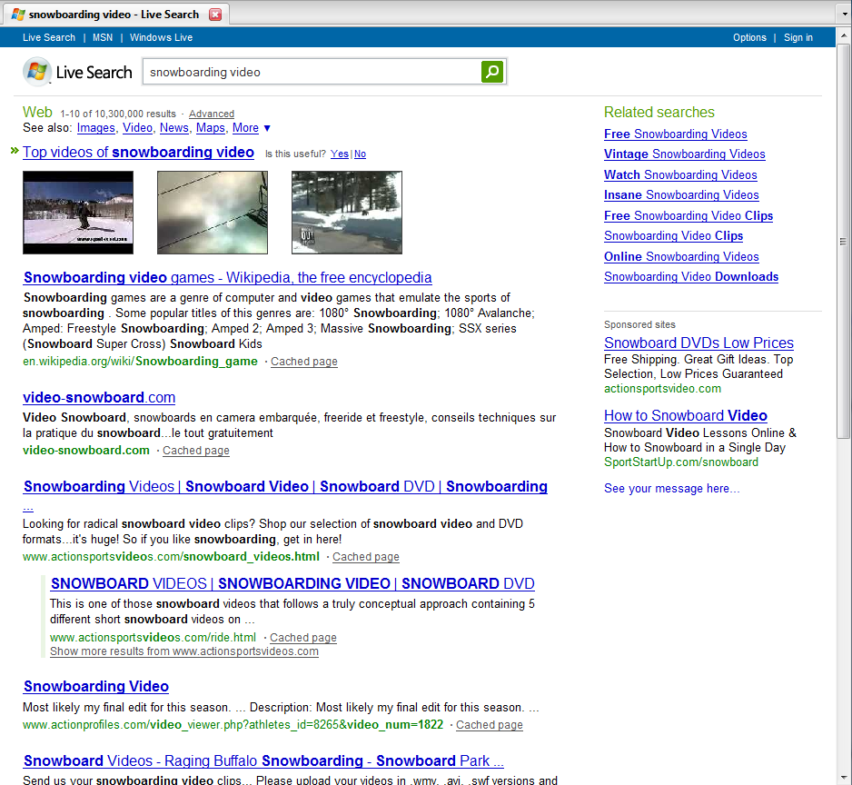
Define: SEO

Slide 12
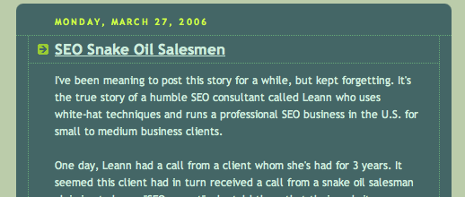
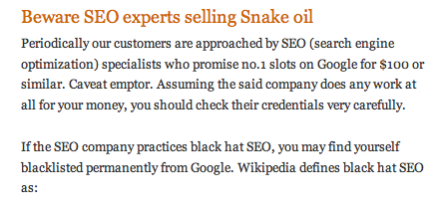
SEO != SPAM

Slide 13
SEO = Good design
Online Resources: www.aslistapart.orgwww.seomoz.orgwww.sitepoint.com

Slide 14
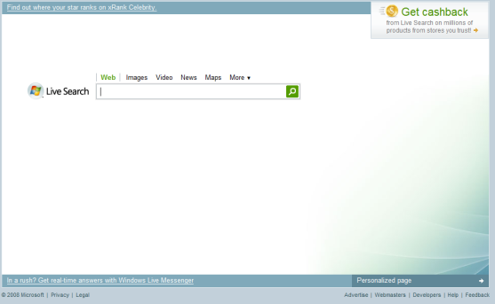
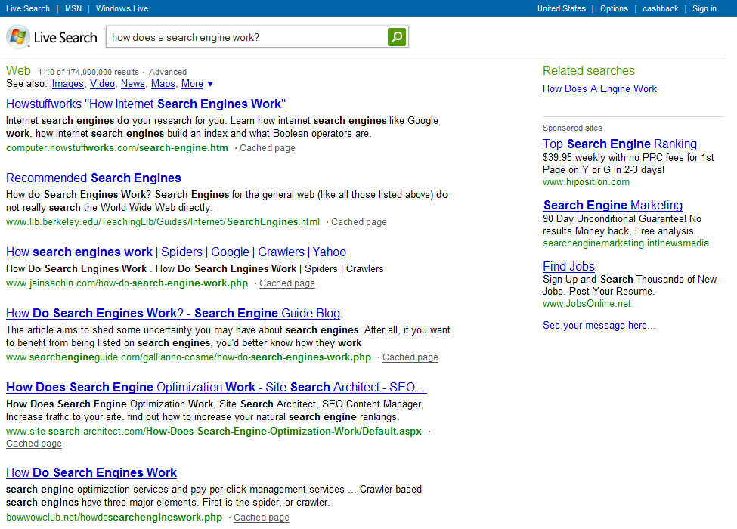
How search works
1. Crawling
3. Searching
Query Parsing
Dynamic Ranking
Index
2. Ranking (PageRank)
Notes:
Talking Points
----------------
Implications
If crawling doesn’t work, nothing else matters
If ranking doesn’t work, searching won’t work
What metrics should you use when thinking about SEO?
Crawler accessibility metric
Ranking metric (quality links)
Query term metrics (where you rank for separate query terms)

Slide 15
Questions?

Slide 16
Building Pages

Slide 17
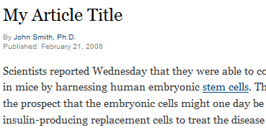
Use HTML Semantically
<h1>My Article Title</h1>
<p>Scientists reported Wednesday…</p>
<span class=“heading1”>My Article Title</span>
<p>Scientists reported Wednesday…</p>

Slide 18
Proper use of common tags
<title>
Description tag is a must; make it short & sweet and unique to the page. You don’t need a keyword tag.
<meta name=“description” content=“”>
Description tag is a must; make it short & sweet and unique to the page. You don’t need a keyword tag.
More Information
Click Here
SEO Presentation (Web 2.0),
Download Pac Man 1.3
<a>
Did you know there is only 1 per page? They signify the most important topic on the page.
<h1>, <h2>, <h3>
Did you know there is only 1 per page? They signify the most important topic on the page.
<noscript>
Actually useful to search engines and people with down-level experiences.
Notes:
SPEAKER NOTES:
--------------------
Validate against some standard, don’t really care which one, just validate.

Slide 19
Improper use of common tags
<script>
No links or redirects locked behind a script tag
<img alt=“”>
Don’t forget to include a description for search engines, and folks with slow connections.
<frame>
If you use this, other web developers will mock you. Are you prepared for that kind of ridicule?
<meta> (the crazy ones: Refresh, Robots/Index,Follow)
You can get caught up in supporting every last meta tag, don’t! Focus on the REP, and Description.
<blink>
Really, I’m just kidding. Did you know MSFT never implemented support for this? When are they going to get onboard with HTML standards! (Still works in Firefox though!)

Slide 20
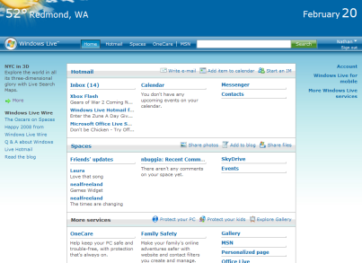
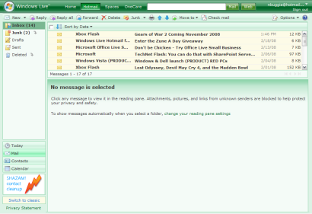
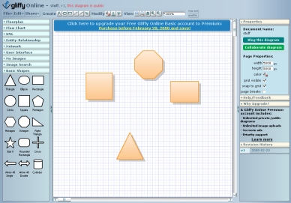
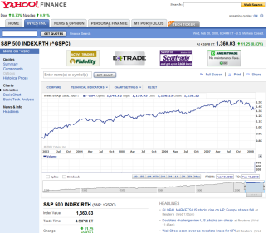
Rich internet applications
Classification | Example | SEO Capabilities | Best Used for
Monolithic Application has 1 URL for the world to see, and is a black box beyond that. Like hosting a rich application online. |  | Entry point indexed | Private data Long usage sessions Desktop-level functionality
Linkable Application is a black box, but there are multiple URL entry-points for collaboration. |  | Full site indexed | Multiple entry points Shareable
Crawlable Application is a small black box meant to spice up a content rich page. |  | Full site indexed and well ranked | ecommerce Content Community/ Viral
Email, TurboTax, Admin Tools
http://giffy.com
http://finance.yahoo.com

Slide 21
ASP.Net & Silverlight
Watch out for ASP.Net post-backs, engines cannot crawl those URLs
XHTML compliance in ASP.Net
Whitepaper
XHTML Compatibility Pack
How to optimize Silverlight for search

Slide 22
Flash: Graceful Degradation
Use Scalable Inman Flash Replacement (sIFR)
Uses JavaScript to render HTML in Flash
Can slow down page loading times
Or use SWFObject to detect no Flash support
Displays HTML instead
Ensure content is exactly the same or could have issues with search engine guidelines

Slide 23
AJAX and JavaScript
Use the <noscript> tag!
<head>
<title>Title Of Your Site</title>
<meta name="Description" content=”description of this page"/>
</head>
<body>
Call AJAX and JavaScript here
<script type="text/javascript">
<!--document.write(”content")//-->
</script>
<noscript>
<p>Same content as in JavaScript</p>
</noscript>
</body>
<html>
Include static HTML links to an HTML page with the same content
AJAX with progressive enhancement (Hijax)

Slide 24
Questions?

Slide 25
Architecting Navigation

Slide 26
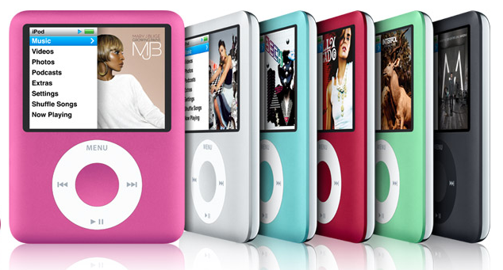
Classing up your URLs
http://store1.com/product.aspx?id=MB147L&SessionId=2344&RegionCode=en-US&format=rich&cat=3
http://store2.com/mp3_players/Apple_ipod_nano_16_G2_Black/
http://store3.com/mp3-players/Apple-ipod-nano-16-G2-Black/
store1.com product.aspx id=MB147L SessionId=2344 | RegionCode=en-US format=rich cat=3
store2.com mp3_players Microsoft_Zune_80_G2_Black
store3.com mp3 Players apple | ipod nano 16 G2 | Black

Slide 27
HTTP status codes
200 OK
404 Gone
301 Moved Permanently
302 Moved Temporarily
304 Not Modified
W3 standard for HTTP Status Codes

Slide 28
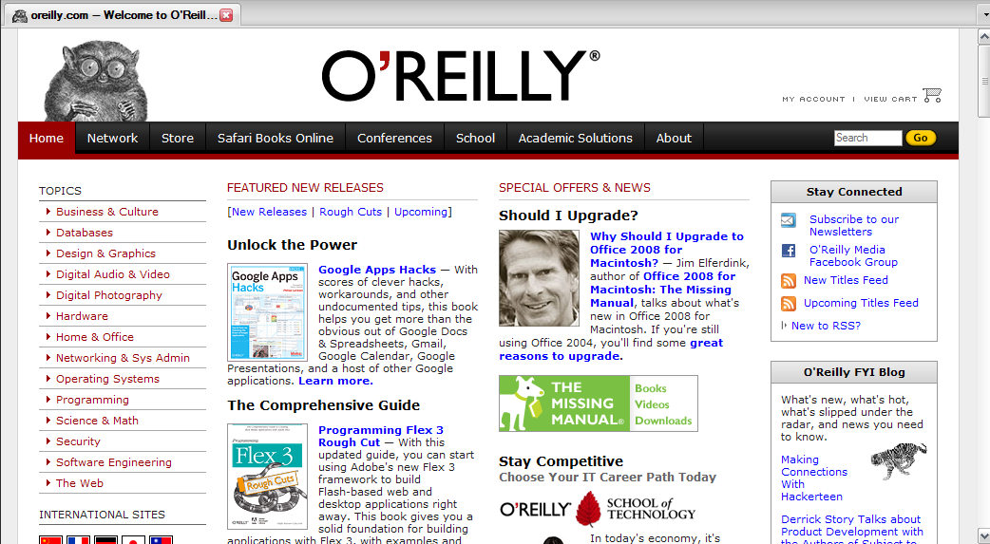
What is the difference?
What’s the difference?
oreilly.com
oreilly.com/index.csp
www.oreilly.com
www.oreilly.com/index.csp

Slide 29
Canonicalization in action
Canonical Form | # Sites Linking In
oreilly.com | 25,030
oreilly.com/index.csp | 0
www.oreilly.com | 1,174,124
www.oreilly.com/index.csp | 0
Check your site’s canonical forms using: Yahoo’s Site Explorer

Slide 30
Canonicalization Recommendation
1) Chose www vs. non-www, 301 redirect one to the other
www.mysite.com → mysite.com
2) Trim your folder-level default filename off the end
mysite.com/default.aspx → mysite.com
3) Make all internal links to the correct canonical form
4) Use Google Webmaster Tools to select www vs non-www.
Detailed article on the issue from Matt Cutts

Slide 31
ASP.Net
URL Rewriting in ASP.Net
Implementation whitepaper
Work around for 404 error pages
Implementing Redirects in ASP.Net
Implementing Redirects in IIS
ASP.Net URL session state management

Slide 32
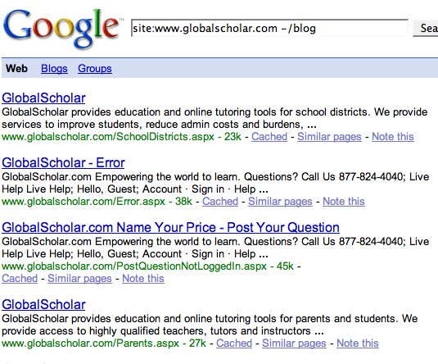
Asp.Net Custom Error Pages
HTTP/1.x 302 Found
Location: http://www.globalscholar.com/Error.aspx
GET /Error.aspx
HTTP/1.1
Host: www.globalscholar.com
Note:See: http://www.colincochrane.com/post/2008/01/ASP-NET-Custom-Errors-Preventing-302-Redirects-To-Custom-Error-Pages.aspx

Slide 33
ASP.Net 301 Redirects
Include in any *.aspx file… (you don’t need a code behind file)
<script>
protected void Page_Load(object sender, EventArgs e) { Response.Status = "301 Moved Permanently" ; Response.AddHeader("Location", "http://mysite.com/new-URL"); }
</script>

Slide 34
Other Redirects
PHP <?php // Permanent redirection header("HTTP/1.1 301 Moved Permanently"); header("Location: http://www.domain.com/"); exit(); ?>
Cold Fusion <CFHEADER statuscode="301" statustext="Moved Permanently”> <CFHEADER name="Location" value="http://www.domain.com/">
JSP <% response.setStatus(301); response.setHeader( "Location", "http://www.new-url.com/" ); response.setHeader( "Connection", "close" ); %>

Slide 35
ASP.Net Canonicalization
Create in your Global.asax file….
protected void Application_BeginRequest(Object sender,
EventArgs e)
{
if (HttpContext.Current.Request.Url.ToString().ToLower().Contains(
"http://www.mysite.com"))
{
HttpContext.Current.Response.Status = "301 Moved Permanently";
HttpContext.Current.Response.AddHeader("Location",
Request.Url.ToString().ToLower().Replace(
"http://www.mysite.com",
"http://mysite.com"));
}
}
More information and examples: http://search.live.com/results.aspx?q=301+redirect+asp.net

Slide 36
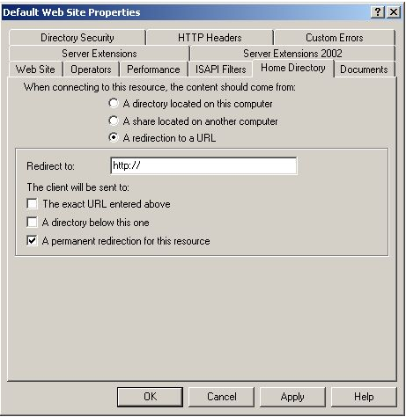
IIS 301 Redirects
Click here for a whitepaper

Slide 37
Apache Redirects
Use .htaccess file for bulk operations:
Moving a single page Redirect 301 /oldpage.html http://www.example.com/newpage.html
Moving a site (and redirecting everything to the home page) Redirect 301 / http://www.example.com
Changing file extension RedirectMatch 301 (.*)\.html$ http://www.example.com$1.php

Slide 38
Apache Canonicalization
Use .htaccess for bulk operations:
Non-www to www (need mod_rewrite enabled) Options +FollowSymlinks RewriteEngine on rewritecond%{http_host} ^domain.com [nc] rewriterule^(.*)$ http://www.domain.com/$1 [r=301,nc]]
Index page to root domain Options +FollowSymLinks RewriteEngine on # index.php to / RewriteCond%{THE_REQUEST} ^[A-Z]{3, 9}\ /.*index\.php\ HTTP/ RewriteRule^(.*)index\.php$ /$1 [R=301,L]

Slide 39
Other Redirect Code
Perl #! /usr/bin/perl use cgi; my $q = cgi->new(); print $q->redirect( -location => 'http://www.newsite.com/newpage.cgi’, -status => 301, );
ss

Slide 40
Questions?

Slide 41
SEO Root-Cause Analysis

Slide 42
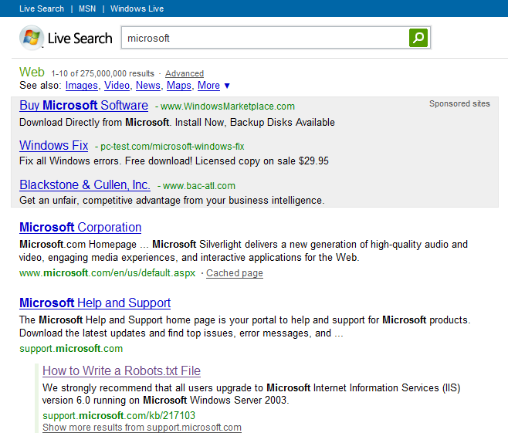
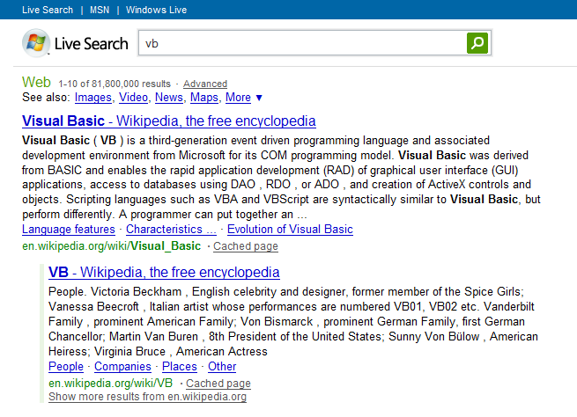
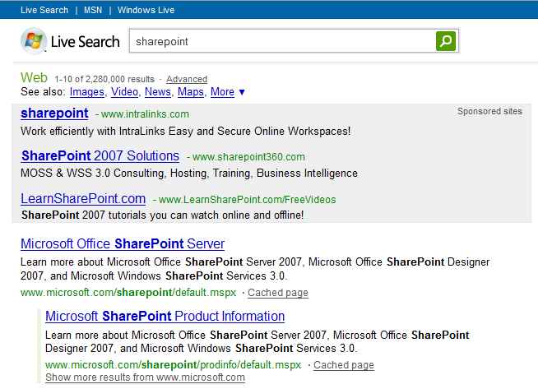
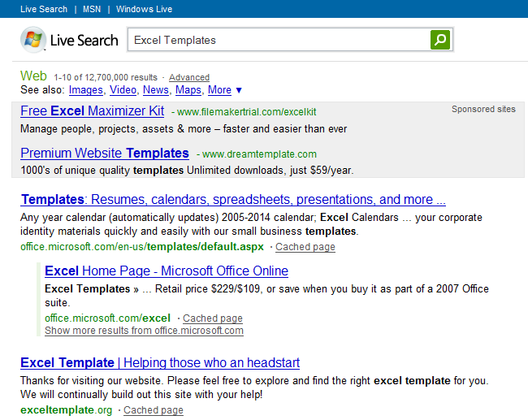
Where to start
1) Branded Search
2) Keywords you want to rank for
Notes:
What to look for

Slide 43
What to look for
Is my site showing up on the first page?
Is my page indexed at all? (site: operator)
Does the SERP result look compelling?
Something that gets people excited to click-on
Good title, description, correct URL
Should your page be cached?

Slide 44
How to debug (Reference)
Accessibility
Check navigation to see if a search engine can access your page
Check your REP to see if the search engine has permission to access
Check if the search engine can parse your page
Ranking
How many people are linking in?
Do you have canonicalization issues?
What anchor text are they using?
How are you linking internally to these pages?
Content
Do you have good, unique content on your pages?
Are you using the language of your customers?
Is your information Architecture optimized?

Slide 45
Tools of the Trade
Accessibility
Webmaster Tools (Live Search, Google)
Firebug
Developer Toolbar
User Agent Switcher
Live HTTP Headers
Html Validator
Ranking
Live Search Webmaster Tools
Rank Checker
Yahoo Site Explorer
Content
AdCenter Excel Keyword Add-in
http://www.vanessafoxnude.com/2008/04/02/diagnosing-site-infrastructure-issues-the-big-list-of-the-best-firefox-plugins/

Slide 46
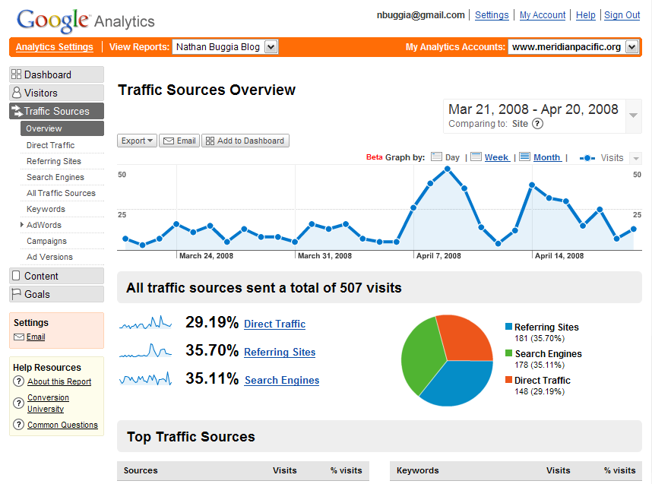
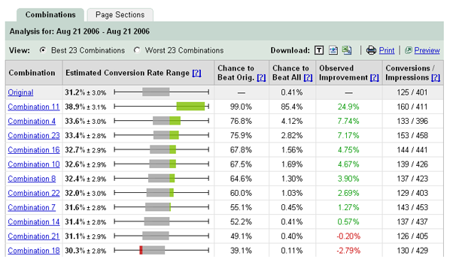
Instrument everything important
Web Metrics
Conversion
http://google.com/analytics
http://adcenter.microsoft.com/analytics
http://google.com/websiteoptimizer
Customer Information!

Slide 47
Summary
Design for your customers
Be smart about robots
Enjoy long-lasting success

Slide 48
Thank you!
Slides:
http://nathanbuggia.com/post/Web-20-Expo-Advanced-SEO-for-Developers.aspx
Contact Me:
Blog: http://nathanbuggia.com
Twitter: nathanbuggia

