Slide 2
Presentation Outline (hidden slide):
Title: Advanced SEO for Developers
Technical Level: 300
Intended Audience: Web Developers
Objectives (what do you want the audience to take away from this session):
1. SEO is a really big deal
2. Top Design Best Practices for SEO
3. How to Diagnose SEO Issues
Presentation Outline (including demos):

Slide 3
Advanced SEO for Developers
Session Code: WUX207
Nathan Buggia
Lead Program Manager
Microsoft Live Search

Slide 4
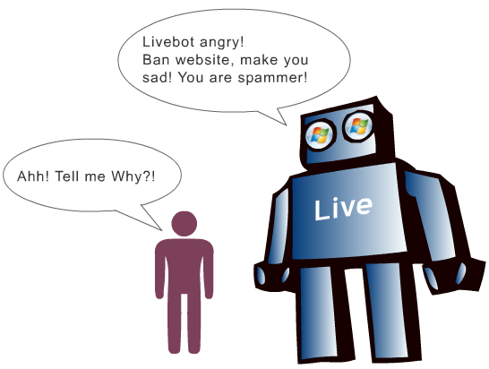
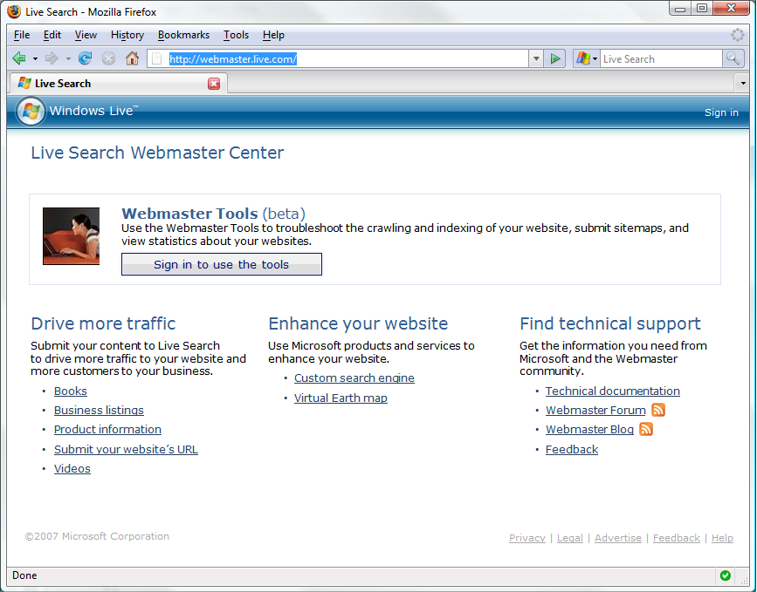
Who is this guy?
And they need it by when?!?
Webmaster Center
Am I being indexed?
Are there any penalties?
How to submit sitemaps?
---------------
Support
Feedback
News
…and they need more tools, and data and technical info, and 302s…
http://webmaster.live.com

Slide 5
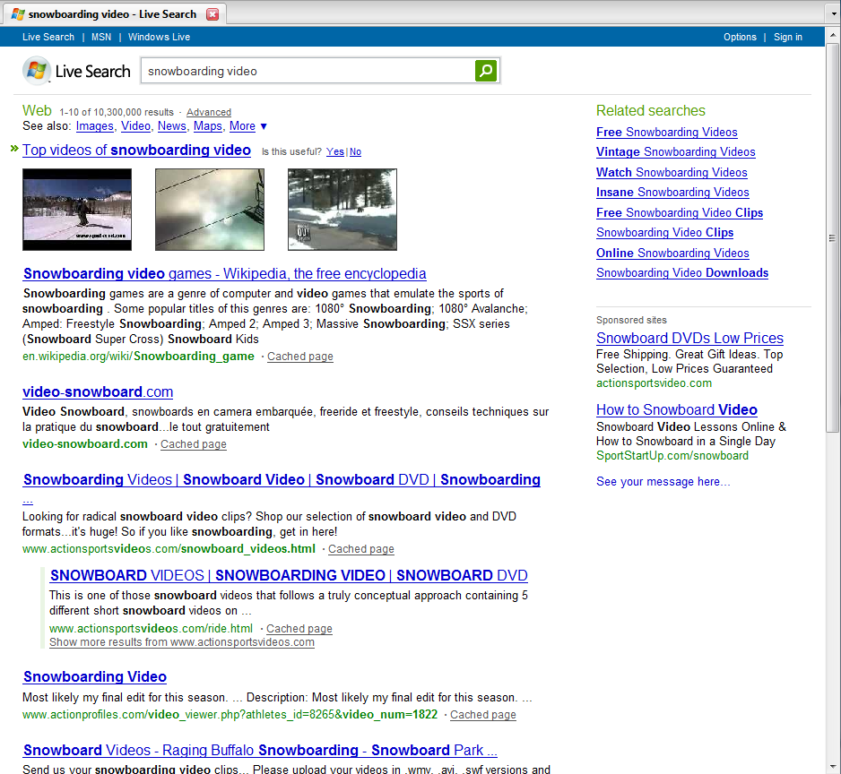

Slide 6
Why should you care about SEO?

Slide 7
SEO = Good design
Online Resources: www.aslistapart.org, www.seomoz.org, www.sitepoint.com

Slide 8
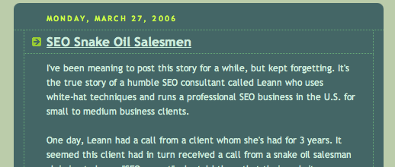
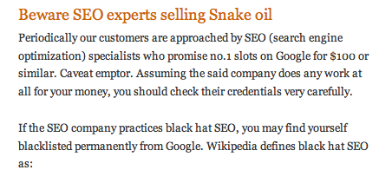
SEO != SPAM

Slide 9
The Equation
Design for your customers
Be smart about robots
Enjoy long-lasting success

Slide 10
Agenda
How search engines work
Building pages
Architecting navigation
How to diagnose SEO issues
Site Review
Notes:
SPEAKERS NOTES:
---------------------
I’m assuming everyone in the room is a developer, I’m not going to teach you anything new about software development
I’m an expert in search and online marketing
I’m going to instead talk about different design decisions you make, and what their impact will be on search
And possibly provide you with a few design patterns you can use
There will be dedicated time for Q&A in between each session along with a live site view
Submit questions to us real-time and your sites to be reviewed
Plug Dave’s talk next – to learn more about the business side

Slide 11
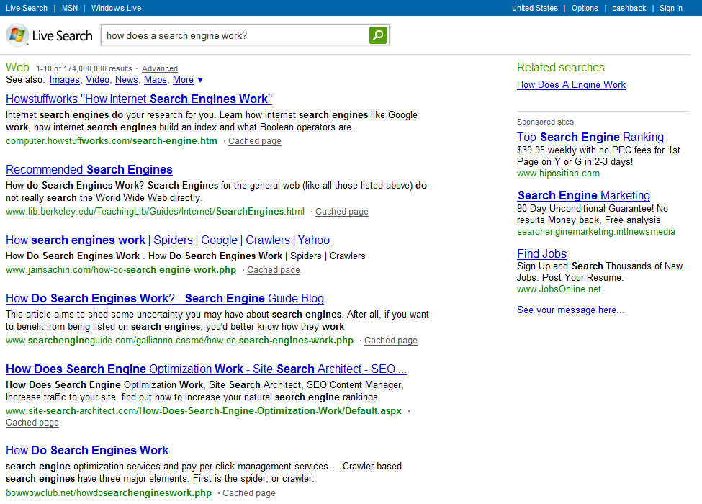
How Search Works
1. Crawling
3. Searching
Index
2. Ranking
Notes:
Talking Points
----------------
Implications
If crawling doesn’t work, nothing else matters
If ranking doesn’t work, searching won’t work
What metrics should you use when thinking about SEO?
Crawler accessibility metric
Ranking metric (quality links)
Query term metrics (where you rank for separate query terms)

Slide 12
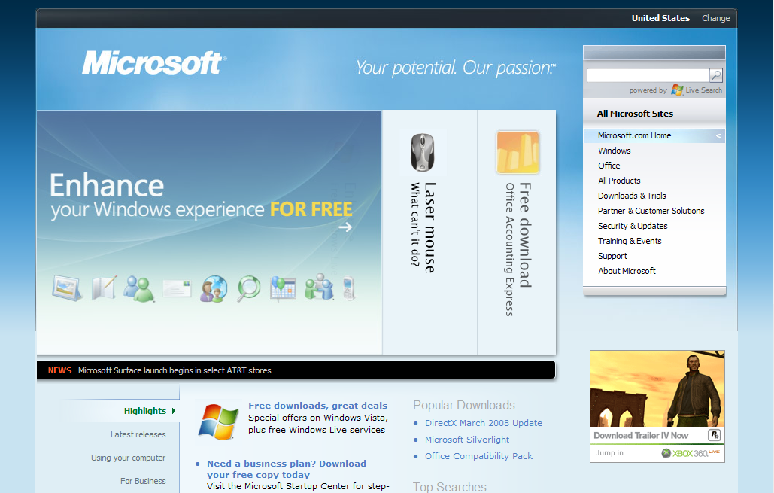
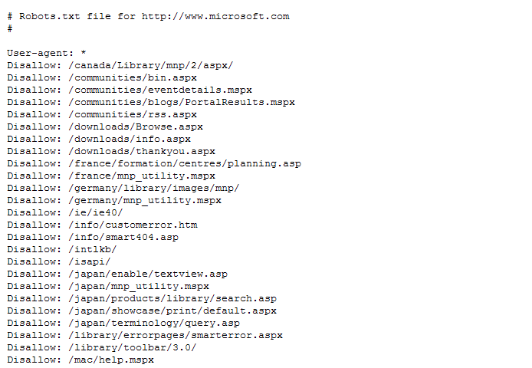
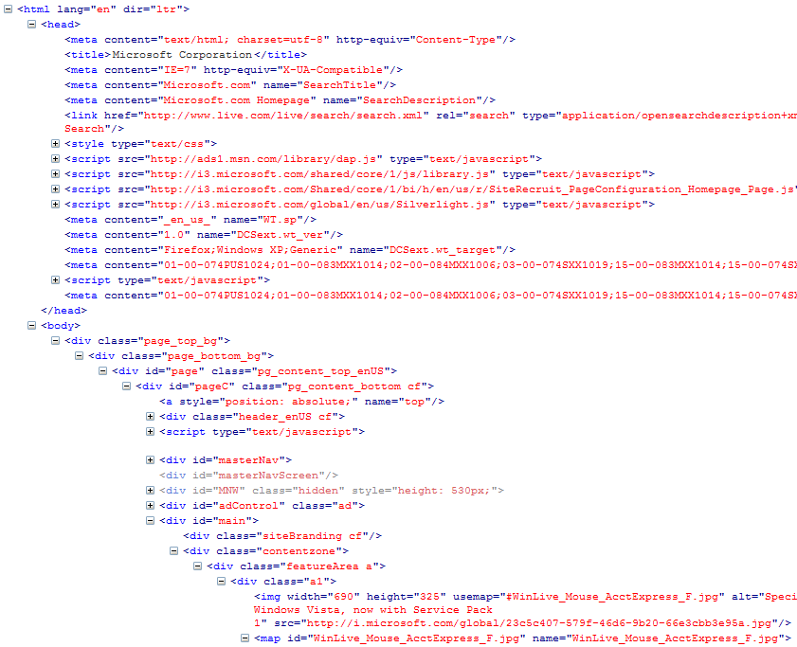
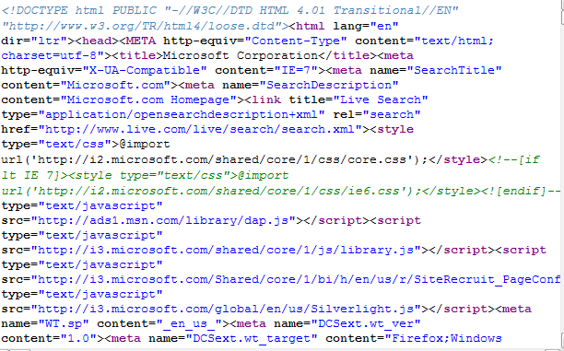
Crawling
Search Engine Thinks:
Hey, nice lookin’ site!
When was the last time I got this page?
When was the last time the page updated?
Can I download this page?
Robots Exclusion Protocol
Network/ Server Error
Can I Process the page?
What is the page about?
What are all the links?
How does this compare to past versions?
How does this compare to related URLs
Does anything look abnormal? (title, h1, text, links)
Maybe I’ll save this page…
Store the Page

Slide 13
Ranking
Rank Is….
Base value of every page in our index
Primarily based on quality and relevancy of inbound links
AND quality of content on your page
Computed for each URL
Computed for each FQDN
Computed periodically
High quality link
Low quality link
Notes:
Highlight what developers need to know:
quality links are really, really important
so are domain structures

Slide 14
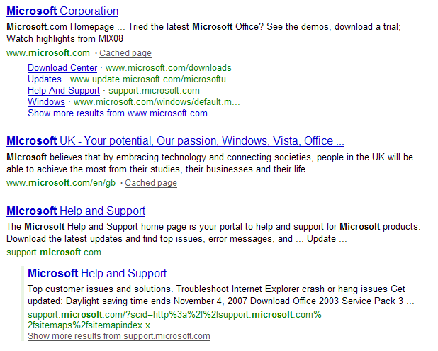
Searching
Let me think….
Is it spelled right?
Do they want a navigational link, a question answered, a video, some websites or maybe an advertisement?
What content can best fulfill their need?
How should I order those results?
Notes:
Highlight what developers need to know:
Keywords come in big here
As does semantic use of HMTL (impacts how we perceive your keywords)
(along with everything previously discussed)

Slide 15
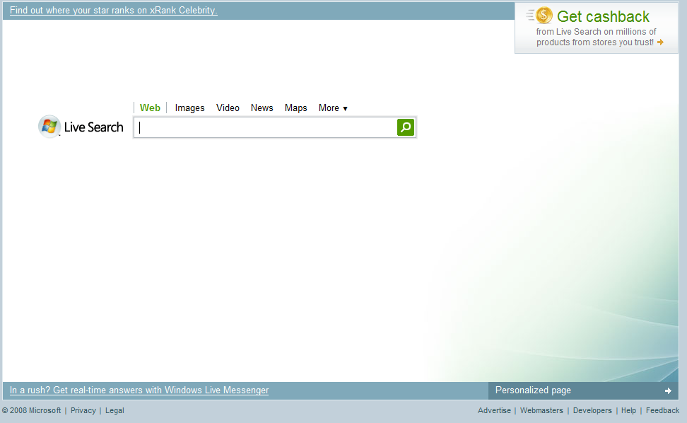
How search works
1. Crawling
3. Searching
Query Parsing
Dynamic Ranking
Index
2. Ranking
Notes:
Talking Points
----------------
Implications
If crawling doesn’t work, nothing else matters
If ranking doesn’t work, searching won’t work
What metrics should you use when thinking about SEO?
Crawler accessibility metric
Ranking metric (quality links)
Query term metrics (where you rank for separate query terms)

Slide 16
Q & A

Slide 17
Building Pages

Slide 18
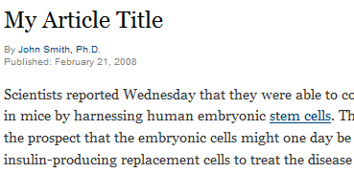
Use HTML Semantically
<h1>My Article Title</h1>
<p>Scientists reported Wednesday…</p>
<span class=“heading1”>My Article Title</span>
<p>Scientists reported Wednesday…</p>

Slide 19
Proper use of common tags
<title>
Description tag is a must; make it short & sweet and unique to the page. You don’t need a keyword tag.
<meta name=“description” content=“”>
Description tag is a must; make it short & sweet and unique to the page. You don’t need a keyword tag.
More Information
Click Here
SEO Presentation (Web 2.0),
Download Pac Man 1.3
<a>
Did you know there is only 1 per page? They signify the most important topic on the page.
<h1>, <h2>, <h3>
Did you know there is only H1 tag1 per page? They signify the most important content
<noscript>, <object>
Actually useful to search engines and people with down-level experiences.
Notes:
SPEAKER NOTES:
--------------------
Validate against some standard, don’t really care which one, just validate. This helps protect you against a wide variety of errors that a browser might correct automatically, but a crawler might not.

Slide 20
Improper use of common tags
<script>
No links or redirects locked behind a script tag
<img alt=“”>
Don’t forget to include a description for search engines, and folks with slow connections.
<frame>
If you use this, other web developers will mock you. Are you prepared for that kind of ridicule?
<meta> (the crazy ones: Refresh, Robots/Index,Follow)
You can get caught up in supporting every last meta tag, don’t! Focus on the REP, and Description.
<blink>
Really, I’m just kidding. Did you know MSFT never implemented support for this? When are they going to get onboard with HTML standards! (Still works in Firefox though!)

Slide 21
ASP.Net Tips
Validate your pages via http://validator.w3.org/
Watch out for ASP.Net post-backs, engines cannot crawl those URLs
Default Controls (DataGrids) sometimes have post-backs built-in
XHTML compliance in ASP.Net
Whitepaper
XHTML Compatibility Pack

Slide 22
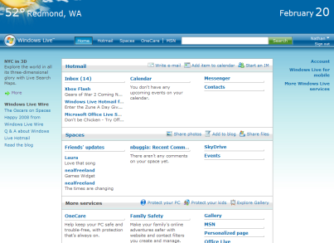
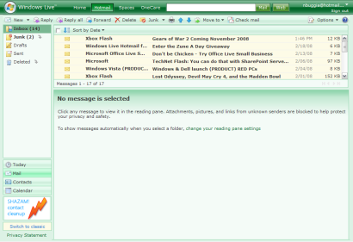
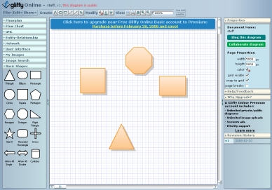
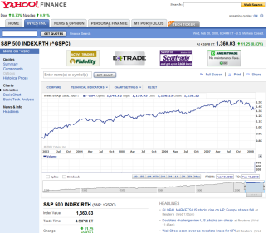
Rich internet applications
Classification | Example | SEO Capabilities | Best Used for
Monolithic Application has 1 URL for the world to see, and is a black box beyond that. Like hosting a rich application online. |  | Entry point indexed | Private data Long usage sessions Desktop-level functionality
Linkable Application is a black box, but there are multiple URL entry-points for collaboration. |  | Full site indexed | Multiple entry points Shareable
Crawlable Application is a small black box meant to spice up a content rich page. |  | Full site indexed and well ranked | ecommerce Content Community/ Viral
Email, TurboTax, Admin Tools
http://giffy.com
http://finance.yahoo.com

Slide 23
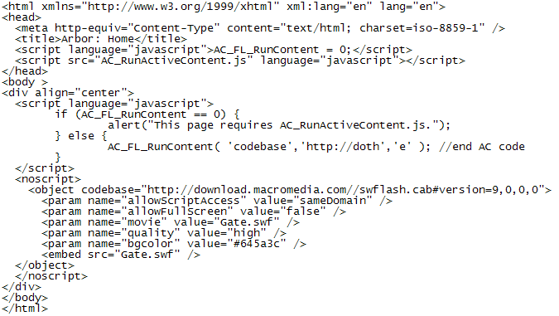
Case Study – Arbor Snowboards

Slide 24
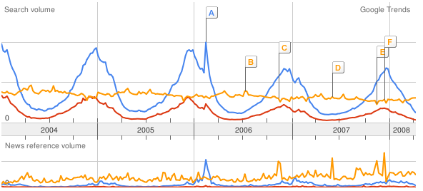
Impact on Search Results
 | arbor | snowboards | snowboard
Google | 1 | 49 | 500+
Yahoo | 1 | 80 | 500+
Live Search | 3 | 128 | 500+

Slide 25
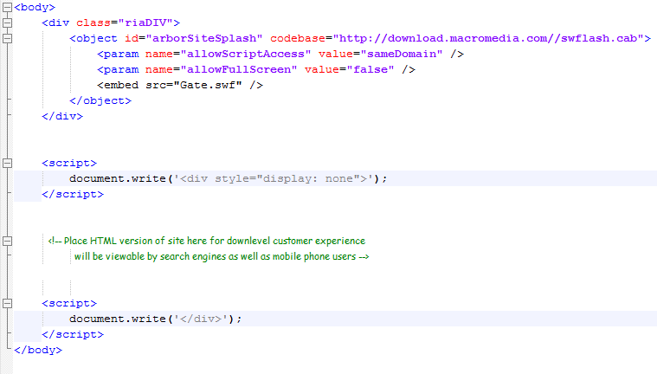
Alternate Implementation
Nikhil’s Design Pattern - http://www.nikhilk.net/AjaxSEO.aspx

Slide 26
AJAX Tips
Use the <noscript> tag!
<head>
<title>Title Of Your Site</title>
<meta name="Description" content=”description of this page"/>
</head>
<body>
Call AJAX and JavaScript here
<script type="text/javascript">
<!--document.write(”content")//-->
</script>
<noscript>
<p>Same content as in JavaScript</p>
</noscript>
</body>
<html>
Include static HTML links to an HTML page with the same content
AJAX with progressive enhancement (Hijax)

Slide 27
Q & A

Slide 28
Architecting Navigation

Slide 29
Classing up your URLs
http://store3.com/product.aspx?id=MB147L&SessionId=2344&RegionCode=en-US&format=rich&cat=3
http://store2.com/Microsoft_Zune_80_G2_Black/dp/B000J01IPI
http://store1.com/Microsoft-Zune-80-G2-Black/dp/B000JO1IPI/
store3.com product.aspx id=MB147L SessionId=2344 | RegionCode=en-US format=rich cat=3
store2.com Microsoft_Zune_80_G2_Black dp b00j01ipi
store1.com microsoft 80 zune | G2 dp b00j01ipi
Notes:
Change to Zune

Slide 30
HTTP status codes
200 OK
404 Gone
301 Moved Permanently
302 Moved Temporarily
304 Not Modified
W3 standard for HTTP Status Codes

Slide 31
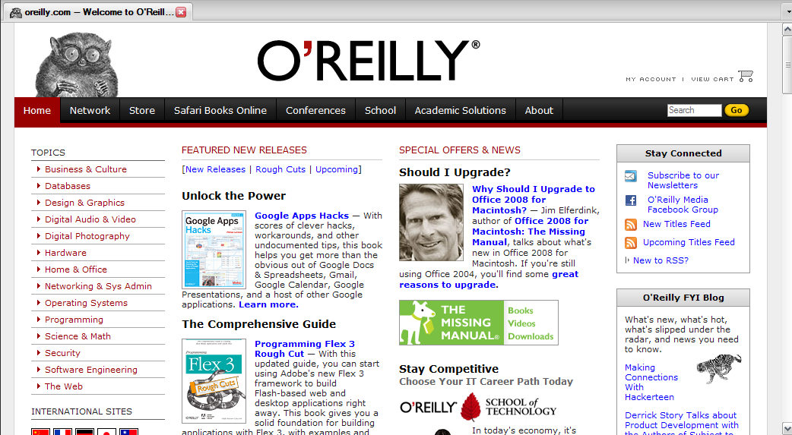
What is the difference?
What’s the difference?
oreilly.com
oreilly.com/index.csp
www.oreilly.com
www.oreilly.com/index.csp

Slide 32
Canonicalization in action
Canonical Form | # Sites Linking In
oreilly.com | 25,030
oreilly.com/index.csp | 0
www.oreilly.com | 1,174,124
www.oreilly.com/index.csp | 0
Check your site’s canonical forms using: Yahoo’s Site Explorer

Slide 33
Canonicalization Recommendation
1) Chose www vs. non-www, 301 redirect one to the other
www.mysite.com → mysite.com
2) Trim your folder-level default filename off the end
mysite.com/default.aspx → mysite.com
3) Make all internal links to the correct canonical form
Detailed article on the issue from Matt Cutts

Slide 34
ASP.Net Tips
URL Rewriting in ASP.Net
Implementation whitepaper
Work around for 404 error pages
ASP.Net has bug in Custom Error Page Handling (find fix here)
Implementing Redirects in ASP.Net
Implementing Redirects in IIS

Slide 35
Advanced Topics (There’s more!)
URL Parameters
State management
Geographic location of content

Slide 36
Q & A

Slide 37
Diagnosing Issues

Slide 38
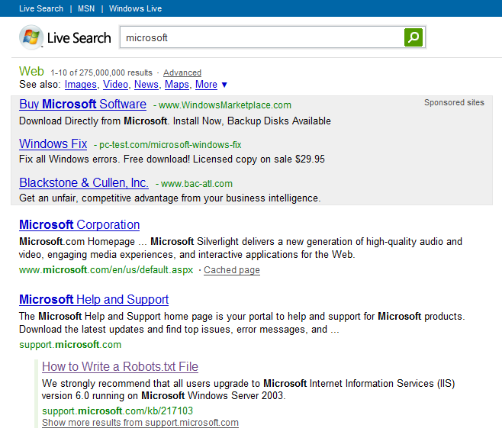
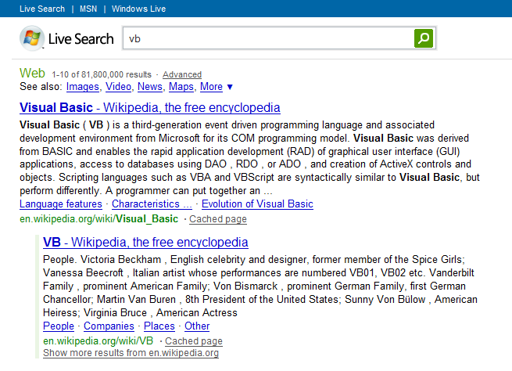
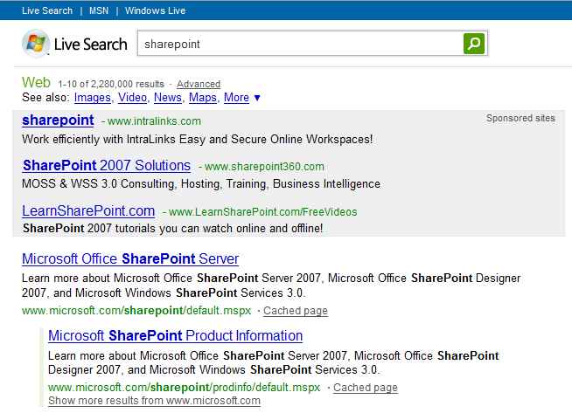
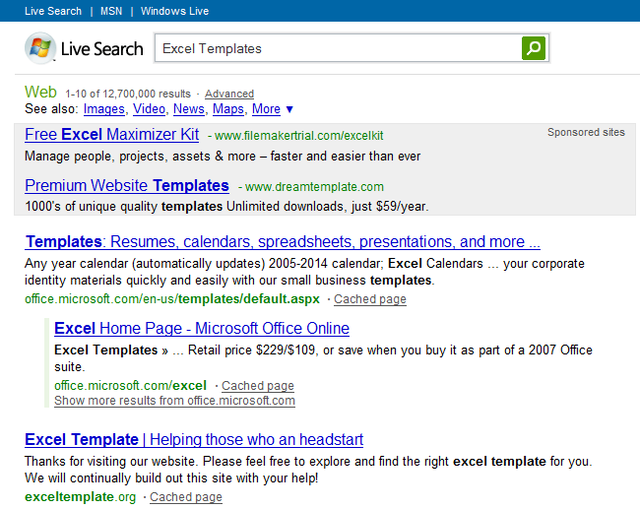
Where to start
1) Branded Search
2) Keywords you want to rank for
Notes:
What to look for

Slide 39
What to look for
Is my site showing up on the first page?
Is my page indexed at all? (site: operator)
Does the SERP result look compelling?
Something that gets people excited to click-on
Good title, description, correct URL
Should your page be cached?

Slide 40
How to debug (Reference)
Accessibility
Check navigation to see if a search engine can access your page
Check your REP to see if the search engine has permission to access
Check if the search engine can parse your page
Ranking
How many people are linking in?
Do you have canonicalization issues?
What anchor text are they using?
How are you linking internally to these pages?
Content
Do you have good, unique content on your pages?
Are you using the language of your customers?
Is your information Architecture optimized?

Slide 41
Tools
Accessibility
Firebug
Developer Toolbar
User Agent Switcher
Live HTTP Headers
Html Validator
Ranking
Rank Checker
Yahoo Site Explorer
Content
AdCenter Excel Keyword Add-in
http://www.vanessafoxnude.com/2008/04/02/diagnosing-site-infrastructure-issues-the-big-list-of-the-best-firefox-plugins/

Slide 42
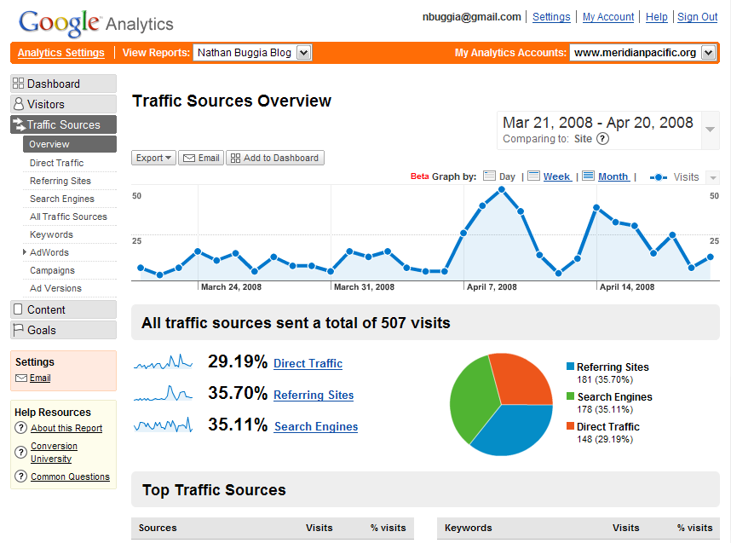
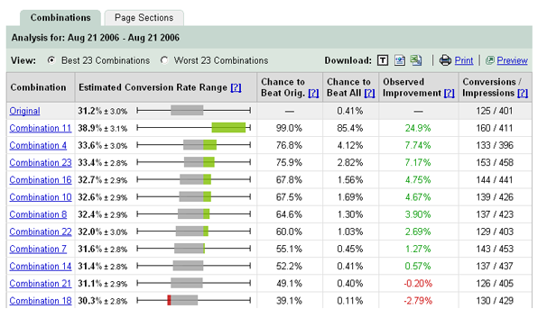
Instrument everything important
Web Metrics
Conversion
http://google.com/analytics
http://adcenter.microsoft.com/analytics
http://google.com/websiteoptimizer
Customer Information!

Slide 43
Q & A

Slide 44
Site Review

Slide 45
The first clue
Was #1 result on all engines a couple months ago.
Ranking #3 or #4 on page (under scott guthrie)

Slide 46
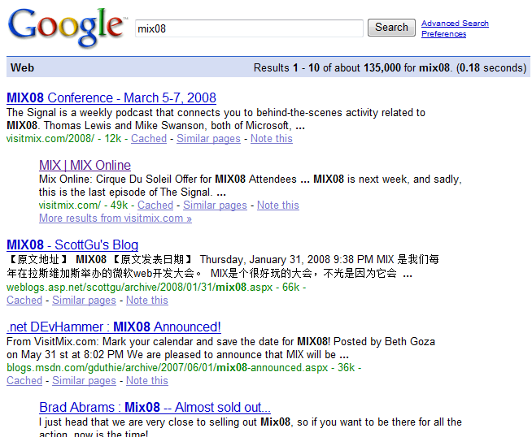
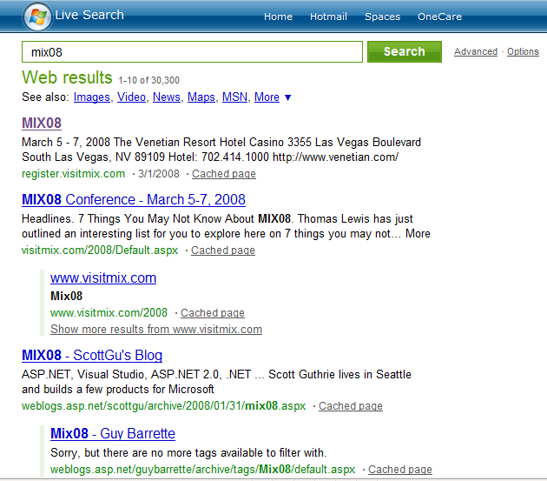
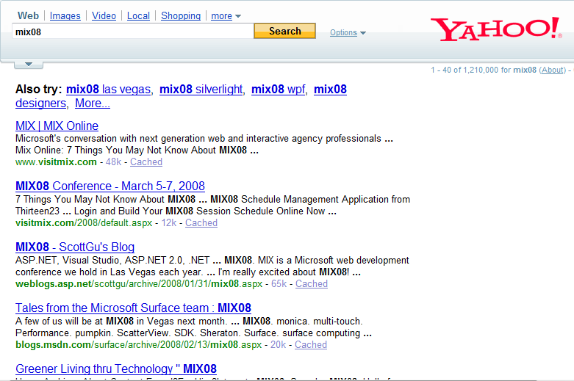
Are there any problems?
Query term: mix08
Desired URL: http://visitmix.com/2008

Slide 47
Summary of Issues
 | Google | Yahoo | Live Search
Ranking | Good | Bad | Bad
Title | Okay | Okay | Okay
Description | Bad | Bad | Bad
URL | Good | Bad | Bad

Slide 48
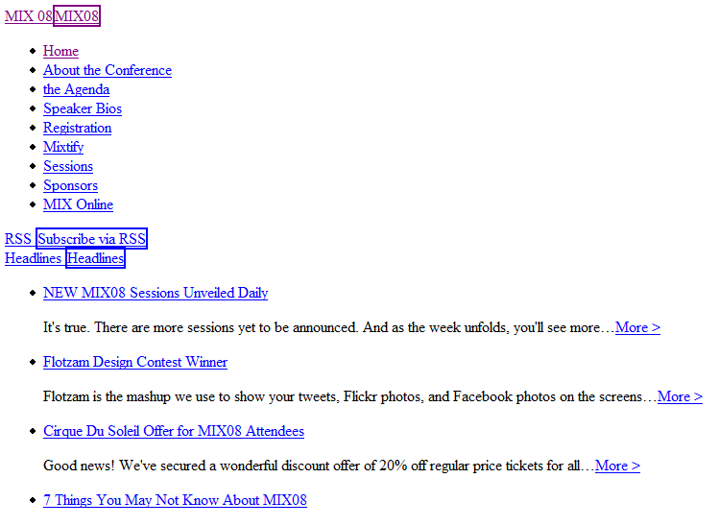
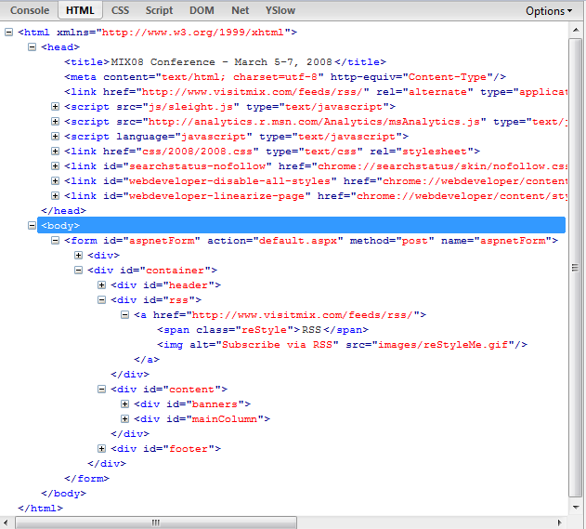
Looking inside visitmix.com

Slide 49
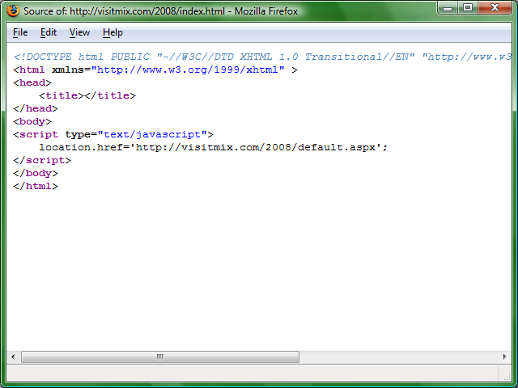
Is this wrong?

Slide 50
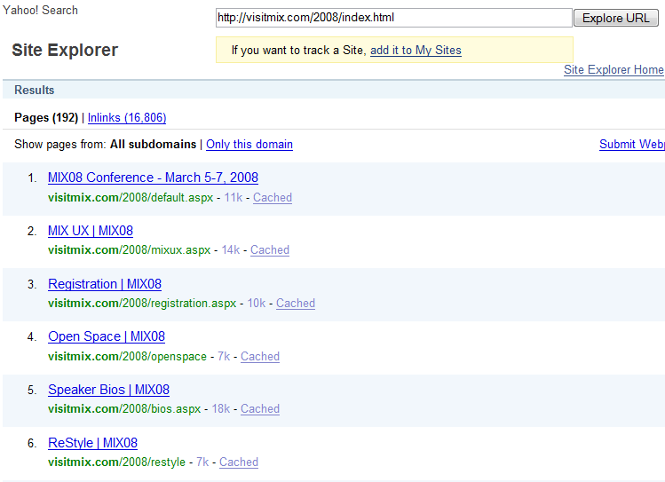
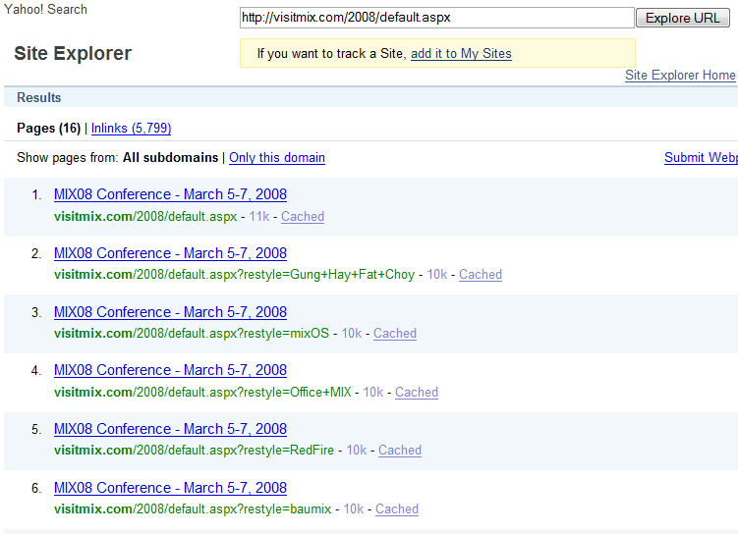
Woops!

Slide 51
Call To Action
Diagnose your own site
Sign up for Webmaster Tools
Contact me if you want to work on a search friendly design pattern

Slide 53
© 2008 Microsoft Corporation. All rights reserved. Microsoft, Windows, Windows Vista and other product names are or may be registered trademarks and/or trademarks in the U.S. and/or other countries.
The information herein is for informational purposes only and represents the current view of Microsoft Corporation as of the date of this presentation. Because Microsoft must respond to changing market conditions, it should not be interpreted to be a commitment on the part of Microsoft, and Microsoft cannot guarantee the accuracy of any information provided after the date of this presentation. MICROSOFT MAKES NO WARRANTIES, EXPRESS, IMPLIED OR STATUTORY, AS TO THE INFORMATION IN THIS PRESENTATION.

Slide 54
Appendix

Slide 55
ASP.Net 301 Redirects
Include in any *.aspx file… (you don’t need a code behind file)
<script>
protected void Page_Load(object sender, EventArgs e) { Response.Status = "301 Moved Permanently" ; Response.AddHeader("Location", "http://mysite.com/new-URL"); }
</script>

Slide 56
Other Redirects
PHP <?php // Permanent redirection header("HTTP/1.1 301 Moved Permanently"); header("Location: http://www.domain.com/"); exit(); ?>
Cold Fusion <CFHEADER statuscode="301" statustext="Moved Permanently”> <CFHEADER name="Location" value="http://www.domain.com/">
JSP <% response.setStatus(301); response.setHeader( "Location", "http://www.new-url.com/" ); response.setHeader( "Connection", "close" ); %>

Slide 57
ASP.Net Canonicalization
Create in your Global.asax file….
protected void Application_BeginRequest(Object sender,
EventArgs e)
{
if (HttpContext.Current.Request.Url.ToString().ToLower().Contains(
"http://www.mysite.com"))
{
HttpContext.Current.Response.Status = "301 Moved Permanently";
HttpContext.Current.Response.AddHeader("Location",
Request.Url.ToString().ToLower().Replace(
"http://www.mysite.com",
"http://mysite.com"));
}
}
More information and examples: http://search.live.com/results.aspx?q=301+redirect+asp.net

Slide 58
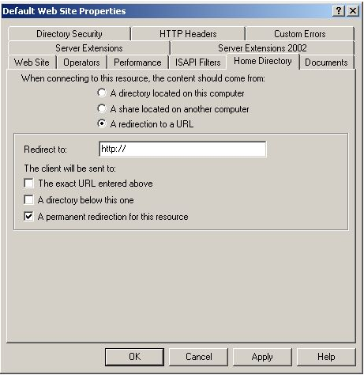
IIS 301 Redirects
Click here for a whitepaper

Slide 59
Notes
In addition to the Walk-in and Title slides, the following slides are required
Please add your content and include these in your final presentation
NEXT: <next slide title>

Slide 60
Deadlines & Resources
Thank you for committing to speak at Microsoft’s premier event for IT Professionals and Developers. Below is important information regarding your participation as a speaker for TechEd 2008.
Important Content Deadlines – submit via www.msteched.com
April 10 | Upload outline and PPT draft
Apr 10–May 25 | Content Review Process (dry run, speaker training, etc.)
May 29 | Presentations locked and final submitted -TechEd Developer. Additional changes must be brought onsite.
Slide Design Resources at www.msteched.com
Graphics and Images Library (pictures of arrows, devices, people)
Books, Webinars, Websites, and much more to help you build a great deck
Licensing information for any third-party photography or art must be submitted with the PPT
Points of Contact
Direct presentation questions to Tespeakr@microsoft.com
Direct content questions to your Track PM: www.msteched.com
This template is designed for use with Office PowerPoint 2007.
This template is set to print in color or grayscale, not black and white.

Slide 61
Scrub Checklist After your presentation is locked, the scrub team will finalize your deck and published it to CommNet 48-hours prior to your session.
Apply template – backgrounds, colors, positioning, font
Verify that required slides are included
Remove any non-template logos and graphics from the walk-in slide
Correct session title and session code to match session guide
Set titles to Title Case and correct widows (widows = single word spilling over to a new line)
Replace transition slides with template transition slides
Set subtitles to subtitle color, size, and sentence case
Correct all type for consistent shadowing
Set bullets to template
Set software code samples to template code format
Correct template application issues as time allows
Correct Microsoft product names to follow corporate branding rules
Correct misspelled words
Remove all comments, hidden slides and speaker notes from slides
Set file properties box
Set printability in grayscale
If time allows, correct slides for readability and consistency
If time allows, correct grammar and correct copy to Microsoft style
Notify Presentation Manager of any images identified as unlicensed for escalation

